Slide 1
The Drug Boom (1965-1975)
And Beyond….

Slide 2
Three factors….
That would unleash the drug’s illicit boom by the 1960s and 1970s.
The collapse of postwar development schemes for Peru’s Huallaga Valley, which brought a coca peasantry into the active intensification of illicit cocaine.
The linkage in the early 1970s of this Andean cocaine capitalism, via cold war events in Chile, to a rapidly rising class of Colombia narcotraficantes, men who would lead cocaine to new markets.
The Nixon-era revolution of politics and culture that underlay the vast new demand for cocaine in post-1960s North America.
“Together, these three shifts of the 1960s and 1970s would transform the legacy of Peru’s historical crude cocaine and the modest smuggling of early narcos into the massive and socially destructive South American drug bonanza of the 1970s and beyond.”

Slide 3
This is the era….
Marked by the rise of Colombia in the global drug trade.
“The transition to Colombian middlemen came in the period 1970-75, hastened by the wave of right-wing military regimes strangling the other smuggling routes and urban cocaine scenes across South America, most dramatically the dictatorship that followed the Chilean coup of 1973, which closed the drug’s most traveled conduit north.”

Slide 4
Even before this….
“sociopolitical conditions were ripe.”
The nation possessed a state that was historically weak and illegitimate due to incessant regional strife since the civil war of the 1950s.
A sadly similar story throughout Latin America (see Guatemala, for example).
But also a class of “modern” economic elites.
And experience with smuggling – in this case “Colombian gold” marijuana.

Slide 5
Archives reveal….
Colombian experiments smuggling cocaine began around 1970.
Yet it was not until 1973 did a noticeable Colombia ascent occur, sparked by the cold war events in Chile.
American officials are able to convince General Pinochet to jail or expel the country’s top nineteen cocaine traffickers.
“The basis for this move was the argument that illicit drug monies might just be used by a regrouping underground Left to threaten state security.”

Slide 6
What did this do?
These events “swiftly disrupted” cocaine routing, sending it north through Leticia, Colombia.
“With thousands of Peruvian and Bolivian peasants already busy at work in the business of producing [coca paste], Colombians eagerly took the opportunity international politics handed them.”
Again, intentional vs. unintentional consequences.
And beginning to embrace violence to keep it all together….

Slide 7
The case of Pablo Escobar
Around 1974, used a car to move cocaine over the Andes (kept it small and simple).
Began to invest his profits in trucks and planes.
“Escobar’s business quickly went wholesale, and he began employing Air Commanders and surplus commercial 727s that could ship ten thousand kilos north in a single foray.”

Slide 8
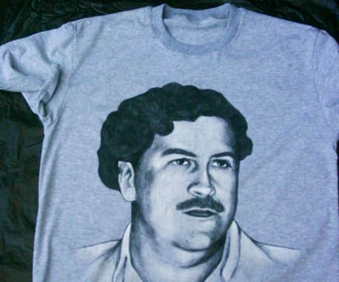
How he is remembered….

Slide 9
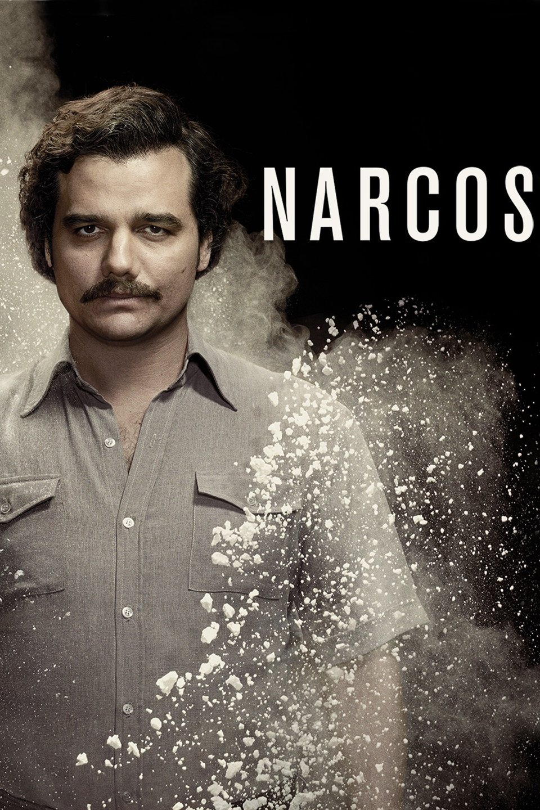
And on television….

Slide 10
By 1975….
Colombians were ferrying an estimated four tons of cocaine to New York City and Miami a year.

Slide 11
The Revival of North American Cocaine
To Gootenberg, it was the political regime of cold warrior – and American President – Richard M. Nixon that was key here.
But before this…

Slide 12
Throughout 1960s….
Attitudes towards drugs of all sorts are changing.
Counterculture brings about new acceptance of drugs.
Cultural figures like rock musicians and folk singers sing about cocaine….

Slide 13
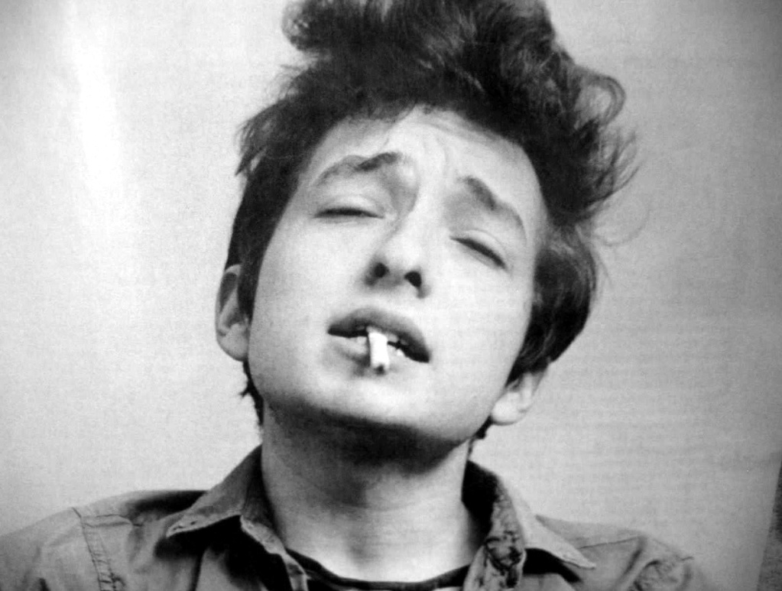
Bob Dylan

Slide 14
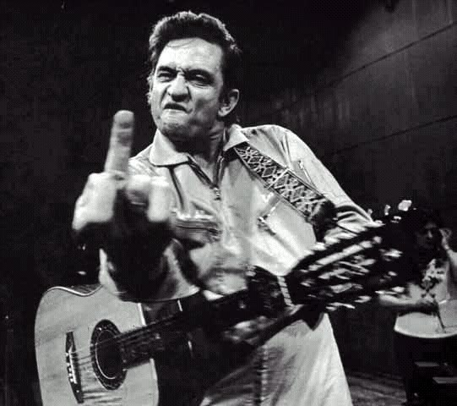
Johnny Cash

Slide 15
And Nixon….
Is starting things like the Drug Enforcement Administration (1973).
Internationalized the War on Drugs, calling on places such as Chile (as we’ve seen), Brazil, and Argentina to go over drug traffickers.
All of this “inadvertently worked to funnel the trade into willing Colombian hands.”
And what was Nixon focusing on? Marijuana, and then heroin.
Why?
Result(s) of this focus?

Slide 16
In 2016….
Former Nixon domestic policy chief John Ehrlichman said this:
“The Nixon campaign in 1968, and the Nixon White House after that, had two enemies: the antiwar left and black people. You understand what I'm saying? We knew we couldn't make it illegal to be either against the war or black, but by getting the public to associate the hippies with marijuana and blacks with heroin. And then criminalizing both heavily, we could disrupt those communities. We could arrest their leaders. raid their homes, break up their meetings, and vilify them night after night on the evening news. Did we know we were lying about the drugs? Of course we did."

Slide 17
So in 1975….
A presidential “White Paper on Drug Abuse” awarded cocaine a “low priority,” because “cocaine does not result in serious consequences such as crime, hospital emergency room admissions, or death.”
Was seen as a “soft drug” of “elites.”
And another culture comes to embrace the drug….

Slide 18

Disco

Slide 19
Within this scene….
“Superficiality, success, and money were back in, and cocaine intensified and highlighted all their sensations and delusions.”
About individual pleasure – which helped it become a part of the “me generation” of the 1980s – who also celebrated ostentatious displays of wealth.

Slide 20
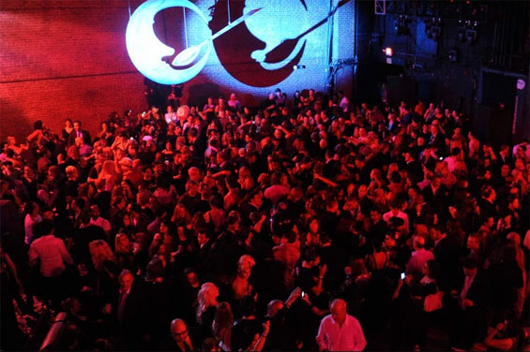
Studio 54….

Slide 21

The crowd at Studio 54….

Slide 22
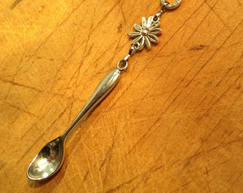
And on the personal level….

Slide 23
And by the 1980s….
Crack cocaine was added as a new product mean to reach new markets and customers.
The deepening slide in cocaine prices throughout the 1980s, combined with the drug market’s saturation, “led to cocaine’s diversification into low-income African American retail markets.”
The drug, in other words, continued to evolve….

Slide 24
And in the 21st Century?
American cocaine lovers still spend in street prices about 38 billion dollars on cocaine each year, amounting to some two-thirds of all illegal drug expenditures in the United States.
And in popular culture?

Slide 25
Compared with the past….
Cocaine’s productive capacity is some one hundred times greater than Peru’s peak legal cocaine output in 1900 and, measured in terms of its prohibition price premium, is among the most lucrative commodity flows in world history.

Slide 26
What….
To make of this end point?

